Slide 1
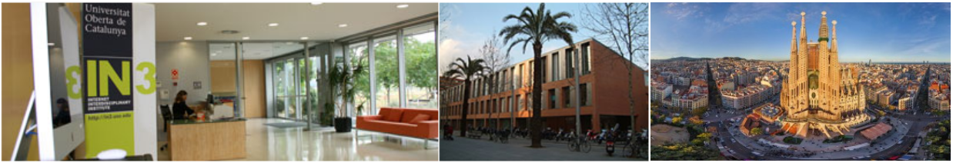







Topic modeling using Non-Negative-Matrix-Factorization (NMF)
Notes:
1
1
1

Slide 2


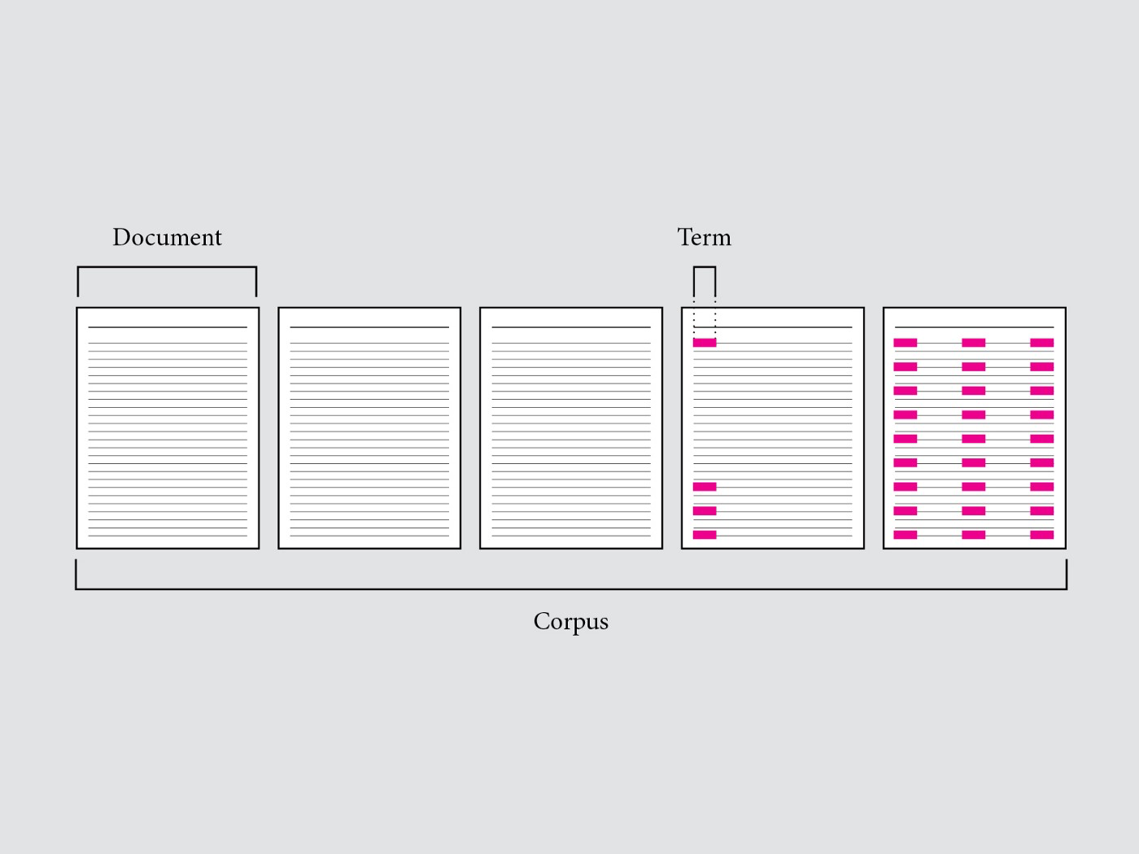
0. Terminology
Corpus refer to a group of similar media. For NMF, this could be a group of texts like articles, audio like songs, or anything that can be conceptualized as the addition of parts . Document refer to one text, photo, song, or video. A term is a word.

Slide 3
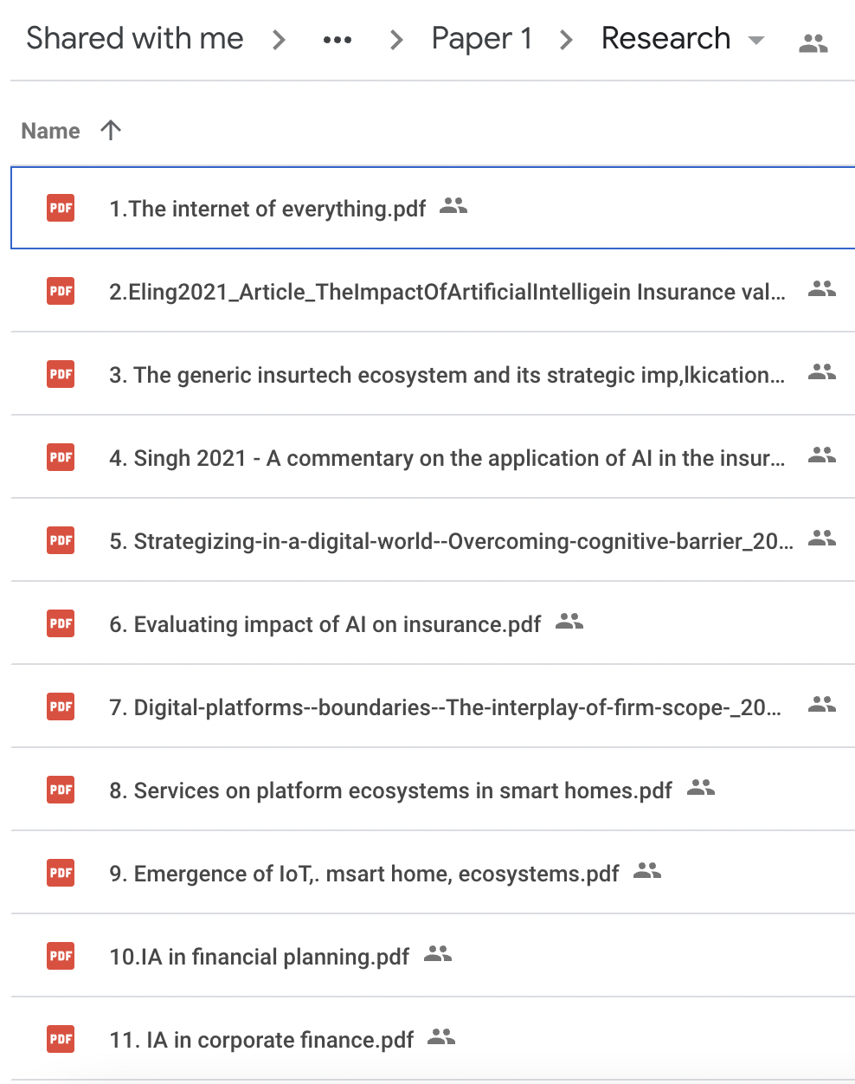
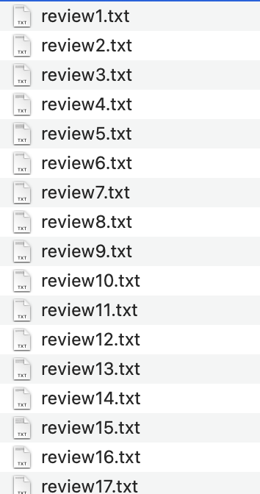
1. Text corpus

Slide 4
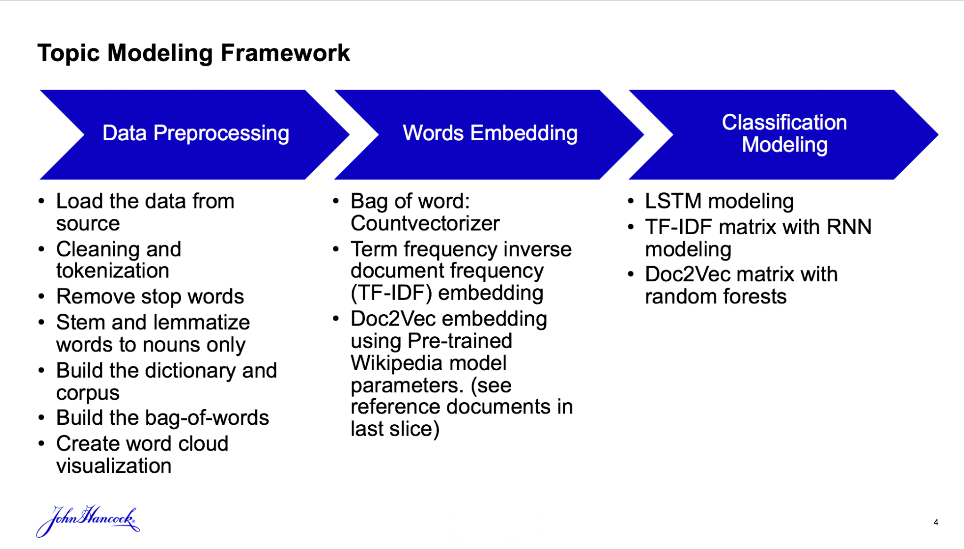
2. Pre-processing of corpus
Convert all term to lowercase: Corpus -> corpus
Remove stop words: 'a', 'about', 'above', 'the', 'to',etc.
Lemmatize all terms: homes -> home, corpora -> corpus, better -> good

Slide 5
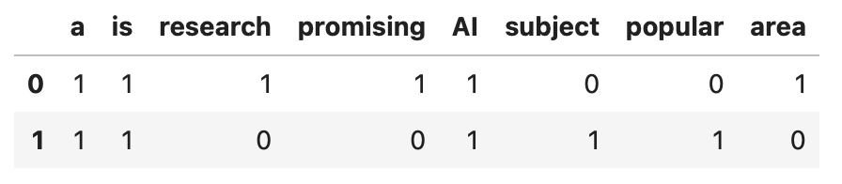
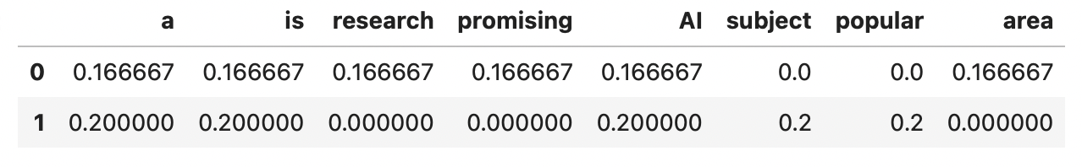
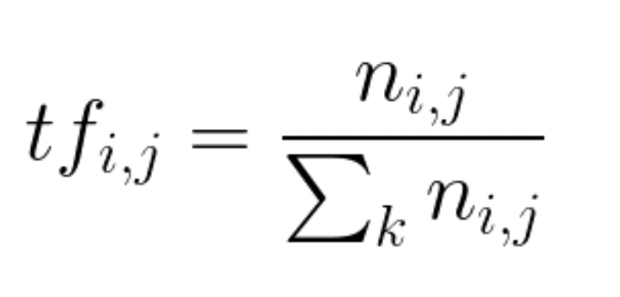
3. TF-IDF of a corpus
Text 0 = 'AI is a promising research area'
Text 1 = 'AI is a popular subject'
Matrix of occurrence of words in each document
Term Frequency (TF) matrix
TF is the number of times a word appears in a document divded by the total number of words in the document:

Slide 6
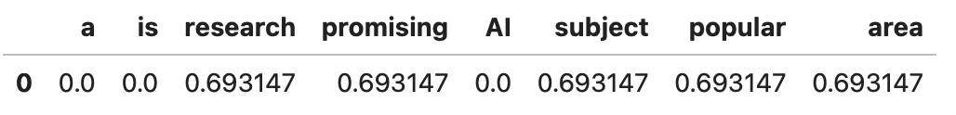
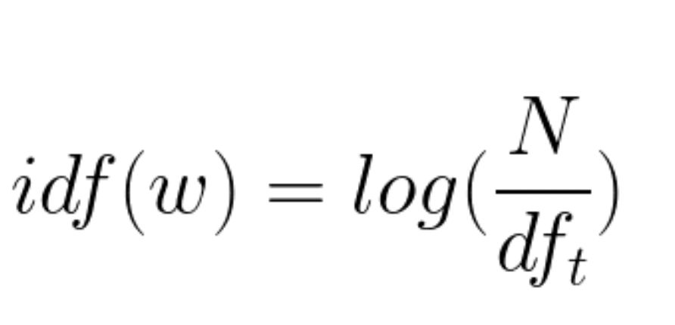
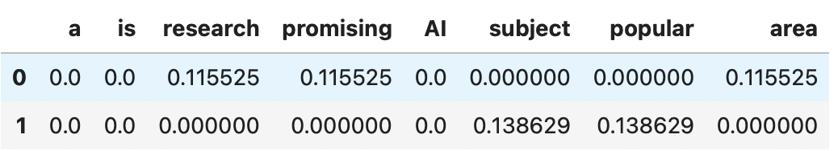
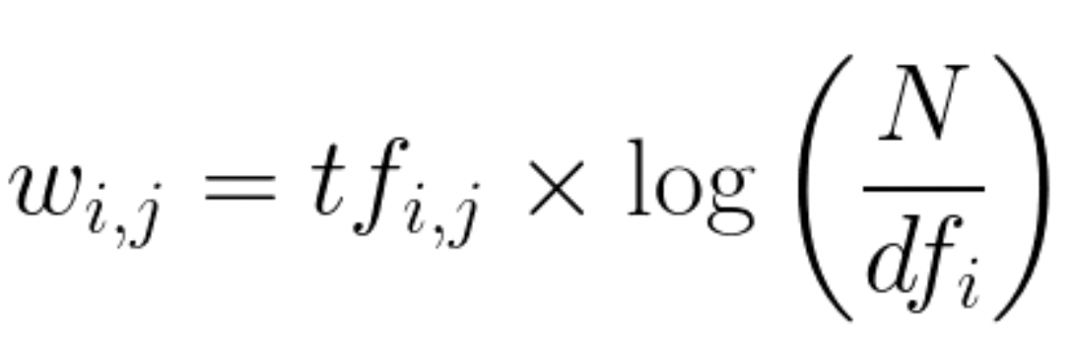
3. TF-IDF of a corpus
Inverse Document Frequency (IDF) matrix
IDF is the log of the number of documents divided by the number of documents that contain the word w. Inverse data frequency determines the weight of rare words across all documents in the corpus:
TF-IDF matrix

Slide 7
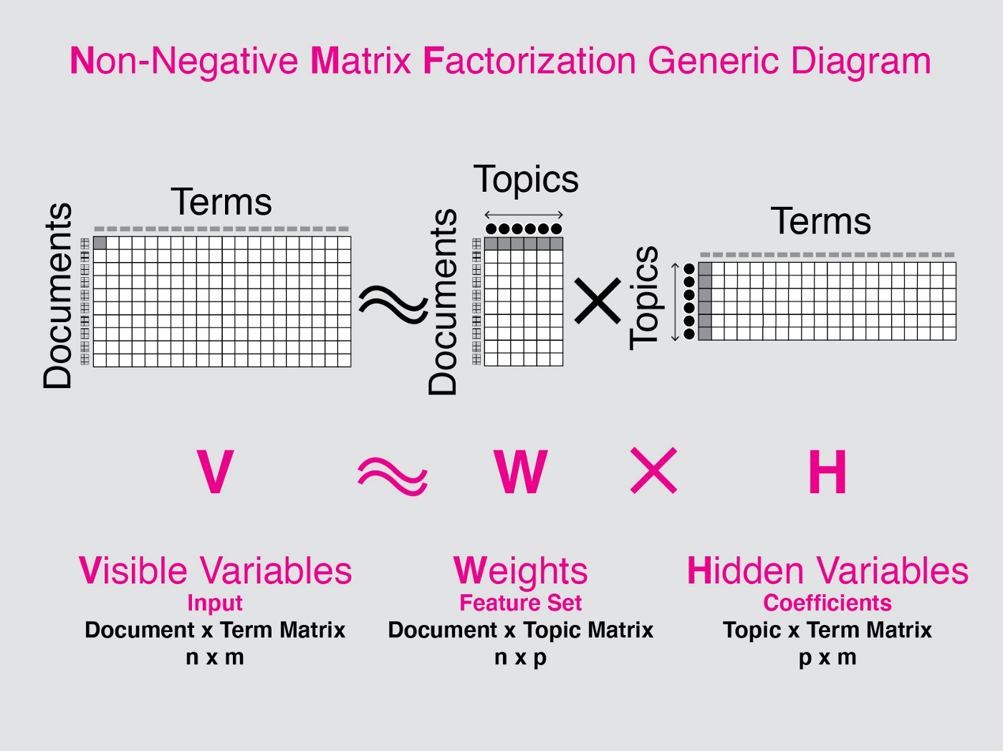
4. Non-Negative Matrix Factorization

Slide 8
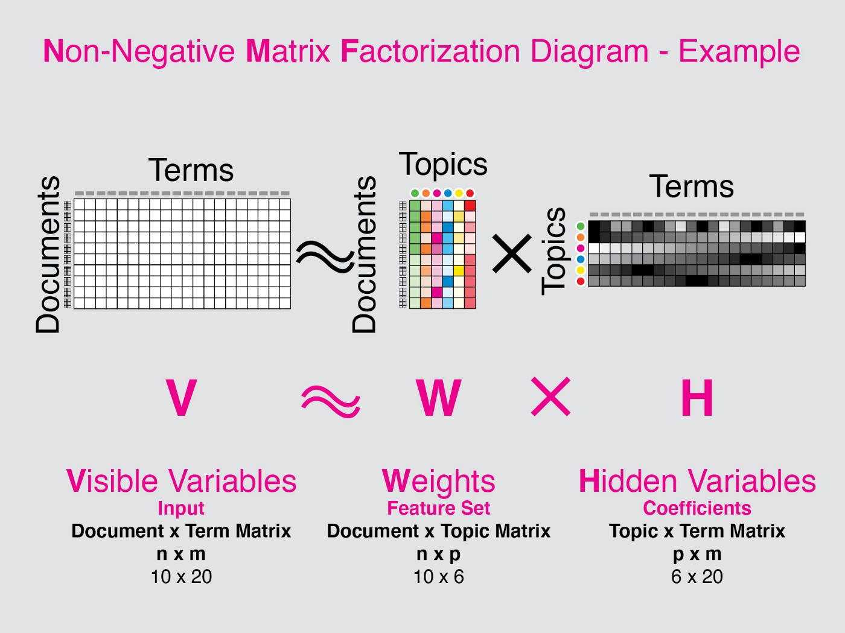
4. Non-Negative Matrix Factorization

Slide 9
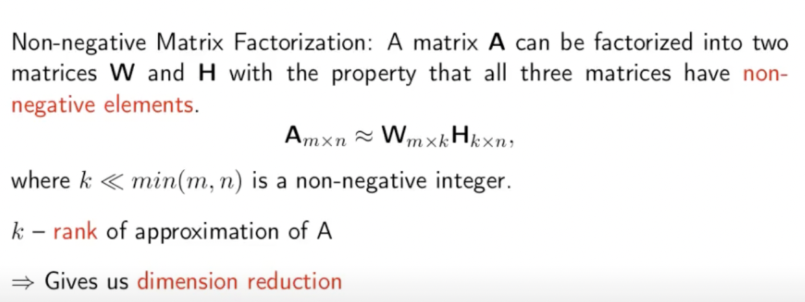
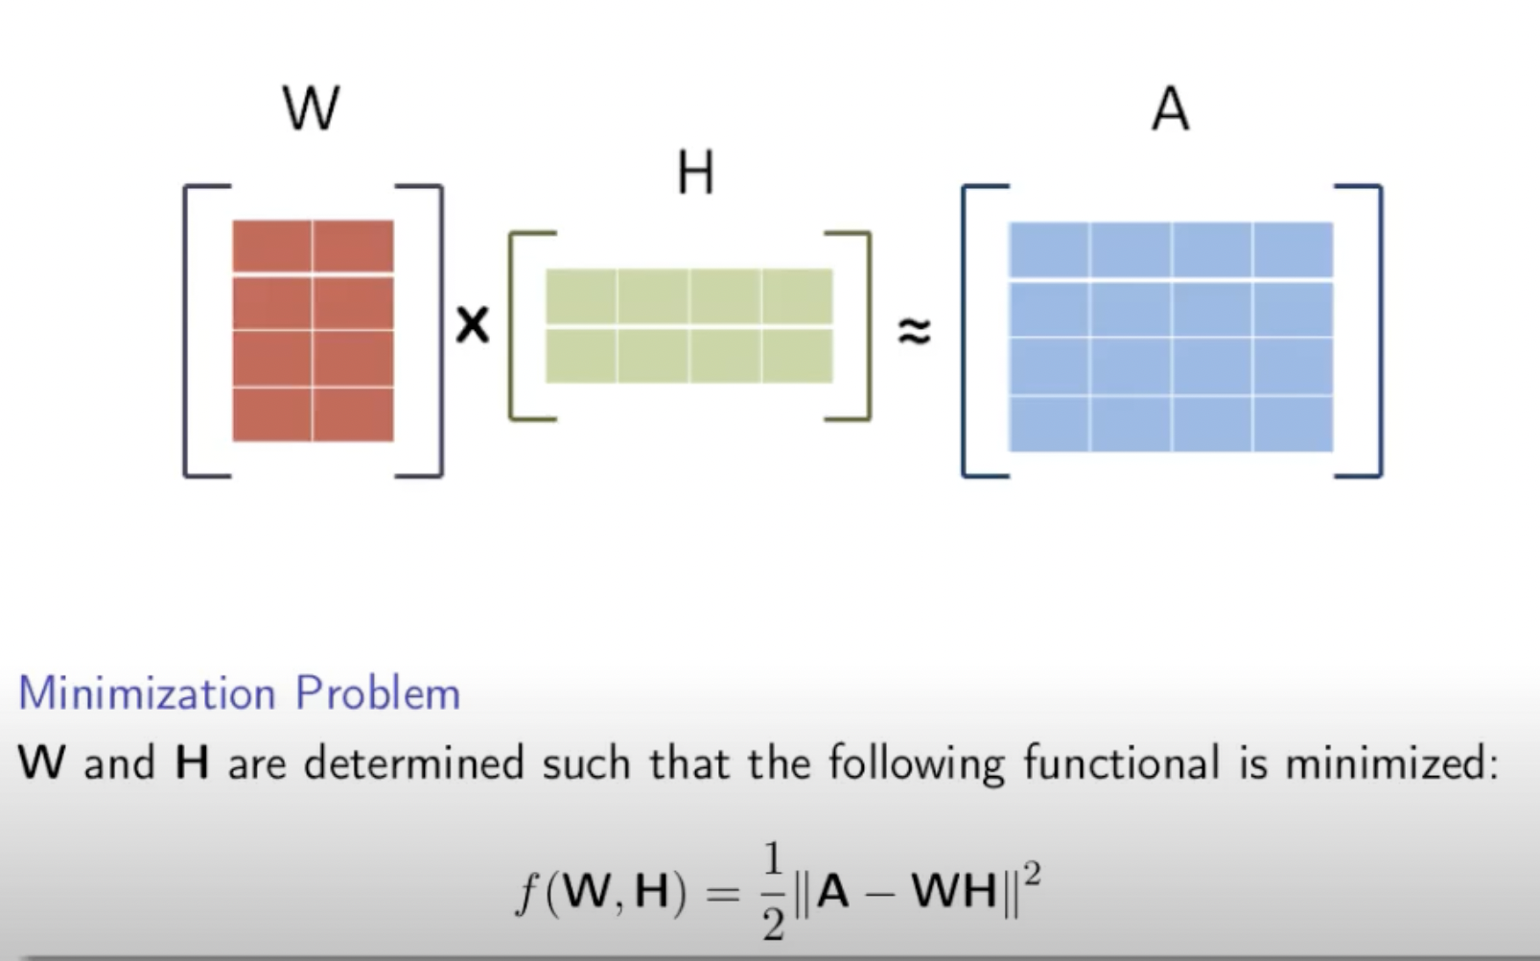
4. Non-Negative Matrix Factorization

Slide 10
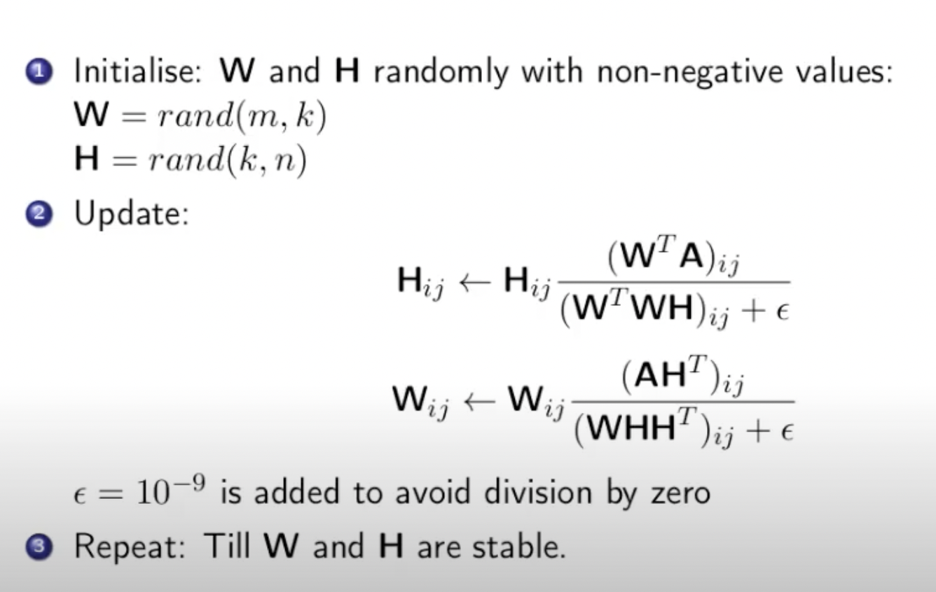
4. Non-Negative Matrix Factorization

Slide 11
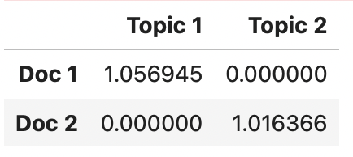
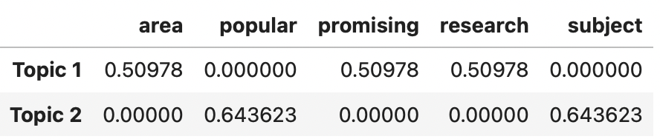
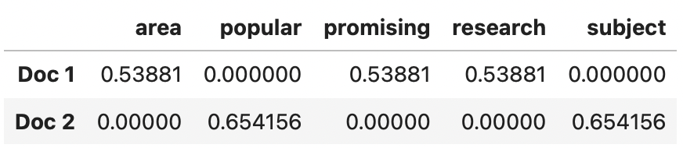
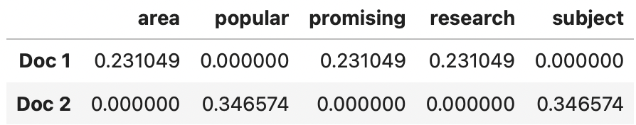
4. Non-Negative Matrix Factorization
Matrix W
Matrix H
The rows of H can be viewed as the weights for every respective term of the unique words contained in the vocabulary of the corpus, representing k topics, giving it a dimensionality of k-by-n. The columns of W then represent the weights relating to each of the D documents in relation to each topic, giving it a dimensionality of m-by-k.
Matrix W*H
Original matrix A

Slide 12
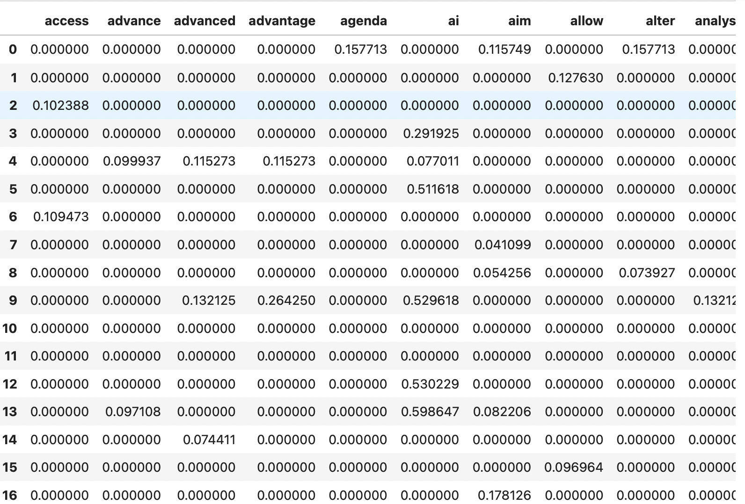
5. Extract topics from the papers
TF-IDF matrix with 30 rows × 195 columns (30 texts with 195 unique words)

Slide 13
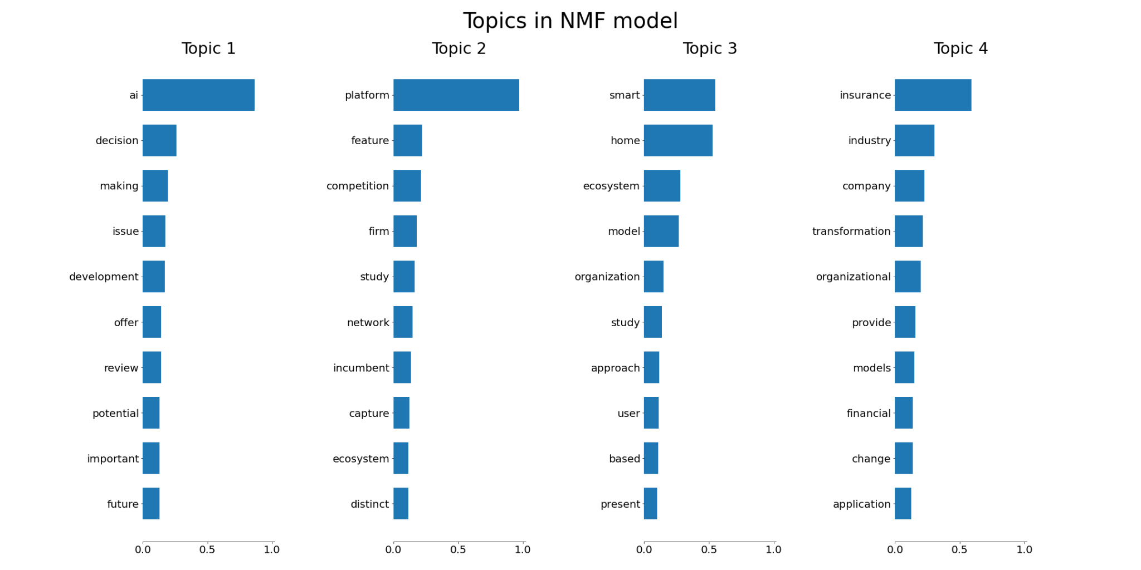
5. Extract topics from the papers
Topic 1: ai decision making issue development offer review potential important future
Topic 2: platform feature competition firm study network incumbent capture ecosystem distinct
Topic 3: smart home ecosystem model organization study approach user based present
Topic 4: insurance industry company transformation organizational provide models financial change application

Slide 14
References
Non Negative Matrix Factorization for Text Classification: https://www.youtube.com/watch?v=ZTxXGZwe2gw
Topic Modeling with SVD & NMF:
https://www.youtube.com/watch?v=tG3pUwmGjsc&t=2000s
Topic Modeling Articles with NMF:
https://towardsdatascience.com/topic-modeling-articles-with-nmf-8c6b2a227a45
NMF — A visual explainer and Python Implementation :
https://towardsdatascience.com/nmf-a-visual-explainer-and-python-implementation-7ecdd73491f8

